Slide 1
Nourish/Nutrition
Notes:
Alisha

Slide 2
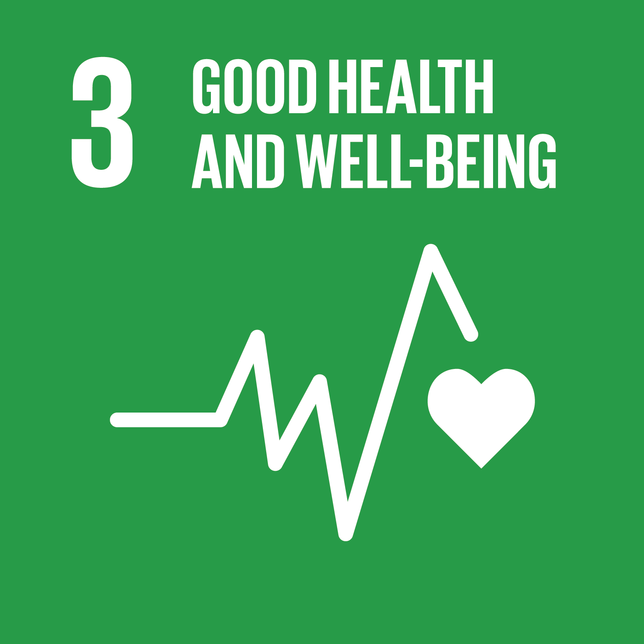
Learning Goals:
Quantitative Reasoning
Personal Qualities
Notes:
Alisha

Slide 3
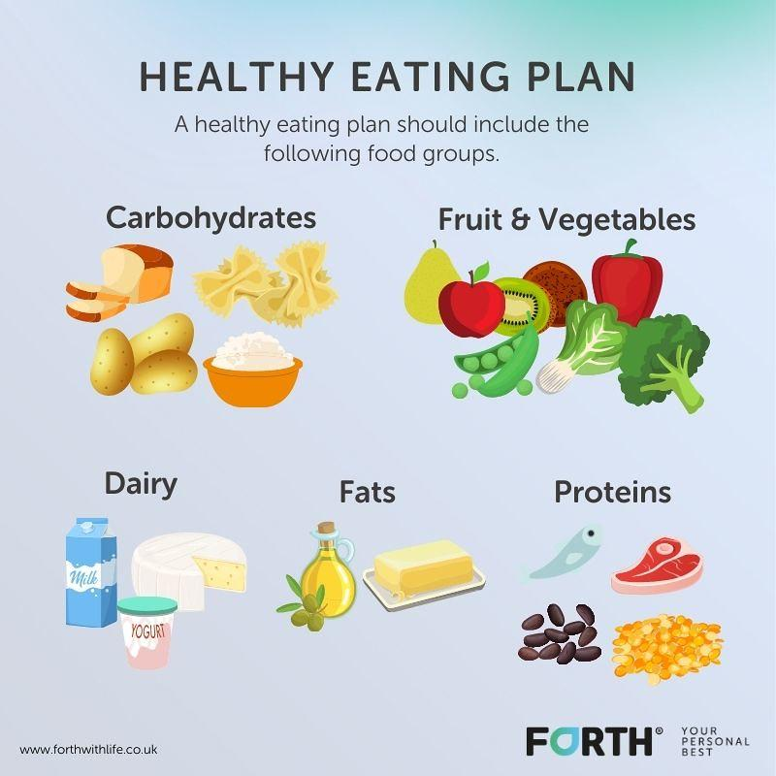
The Plan
DAY ONE = INTRODUCTION
Some Nutrition Basics
DAY TWO = SUGAR IS BAD
Analyze Drinks for Health
DAY THREE = CAFFEINE DANGERS
DAY FOUR = PLAN OF ACTION
Create A “Mini-Project” around what we have learned and do it
Notes:
Alisha

Slide 4
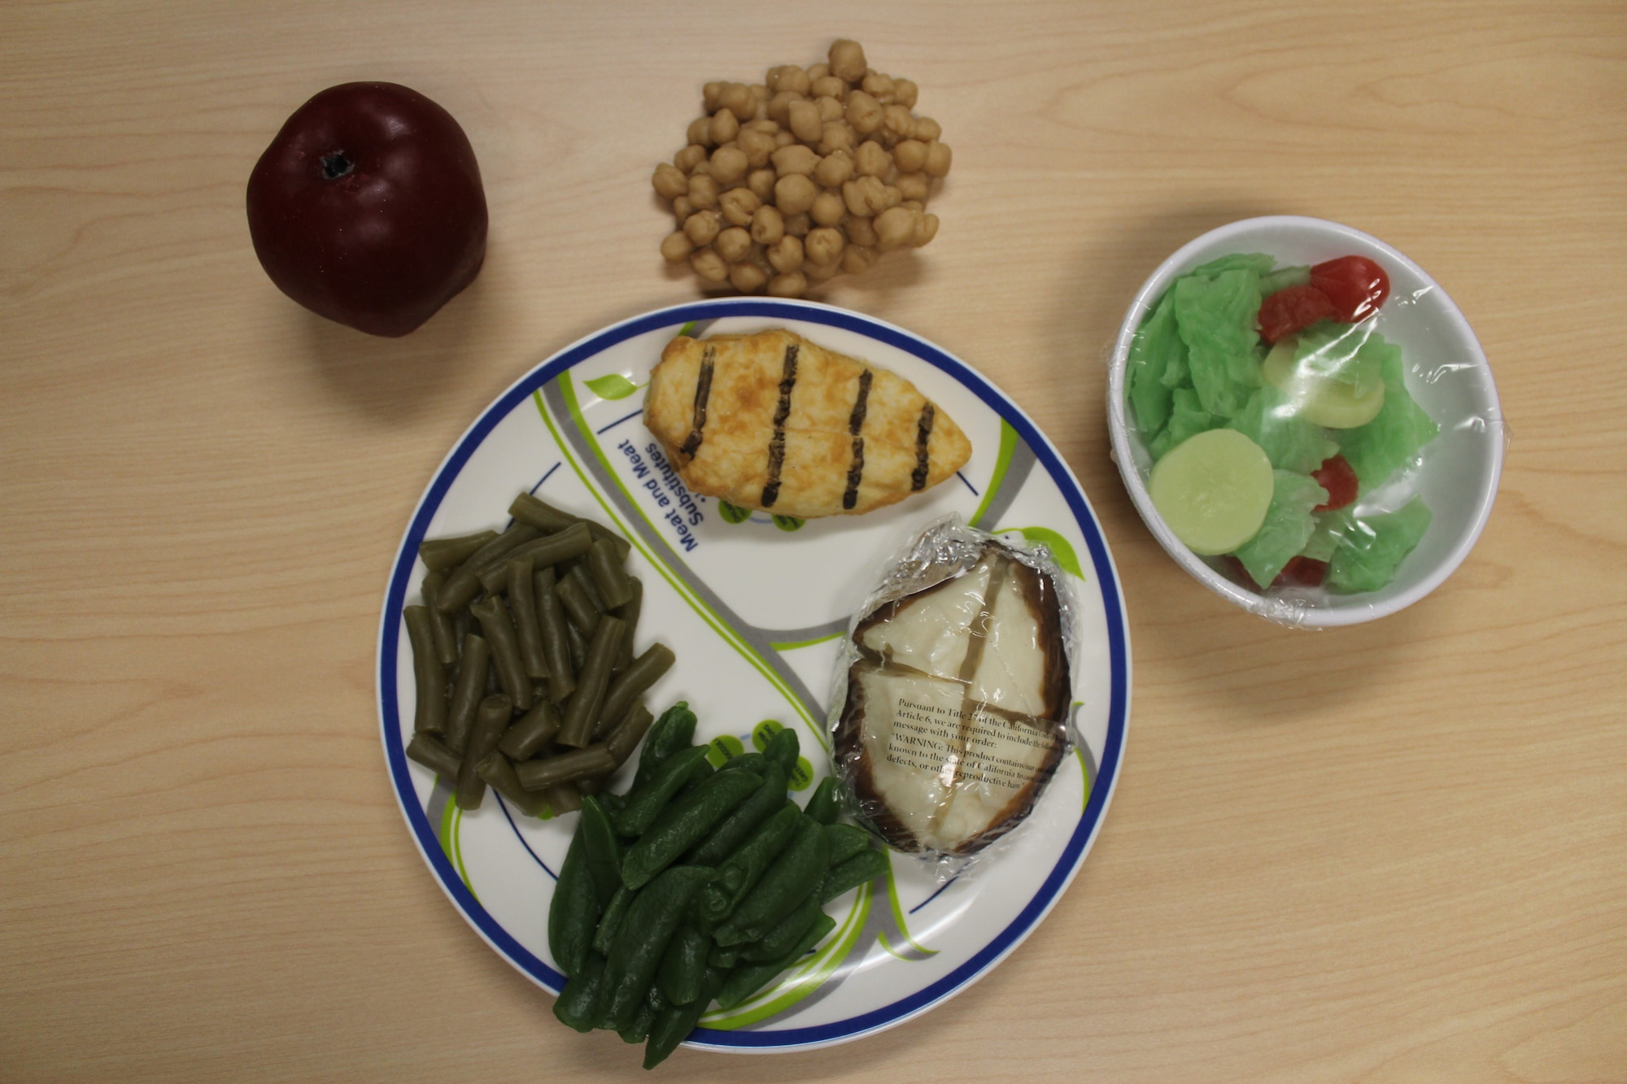
DAY ONE - NUTRITION BASICS
Notes:
Alisha

Slide 5
Day 1: Six Essential Nutrients
Measure: Nourish
Outcomes:
Students will recognize the role that nutrition plays in health
Students will be able to identify key aspects of a healthy eating plan
Discussion: It is important to understand why certain foods are considered healthy. Your body requires six essential nutrients which must be obtained from your diet.
They are as follows:
Vitamins
Minerals
Water
Carbohydrates
Fat
Protein
Activity: Working in pairs, select one of the nutrients to research. You can explore resources on the ACLM’s page on the Big Picture Living website for more information (https://www.bpliving.org/aclm-resources).
Consider why this nutrient is important. What role does it play in your body? How do you consume this nutrient? Where is it found? Create an advertisement for this nutrient and share it on social media. Remember to tag @BPLiving in your post.
Reflection: In your Big Picture Living journal, consider what you learned today about essential nutrients. What small changes can you make in your diet to include these nutrients?
Source: ACLM’s The Teen Lifestyle Medicine Handbook

Slide 6
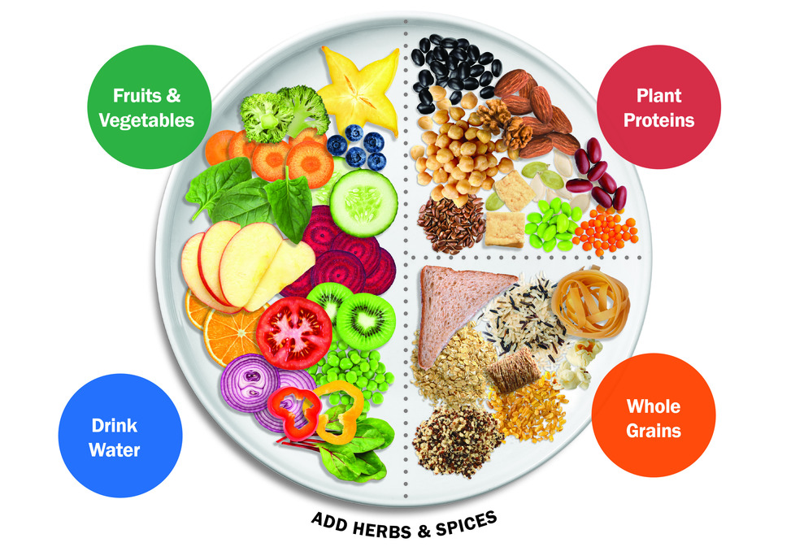
What’s on Your Plate?
Measure: Nourish
Outcomes:
Students will recognize the role that nutrition plays in health
Students will be able to identify WFPB diets
Discussion: The whole food, plant-based (WFPB) plate was designed to illustrate the optimal nutrition and to serve as a tool to compare to your own plate. Consider the division of the plate and how it compares to your normal meals. What is different?
Consider how you might change your daily eating habits to incorporate more whole grains or fresh vegetables. What are the obstacles to reaching this goal?
Activity: Working in alone, compare what you eat and a healthy WFPB plate. Fold a paper in half and draw to large circle to make a plate on each half. One one half, recreate the WFPB plate. On the other side draw what you ate last night. What similarities do you see there? What is different?
Reflection: In your Big Picture Living journal, think of three food/ingredient swaps that you can make this week to build your WFPB plate.
Source: ACLM’s The Teen Lifestyle Medicine Handbook

Slide 7
Dinner Conversations
Measure: Nourish
Outcomes:
Students will recognize the role that nutrition plays in health
Students will be able to encourage others to improve their eating habits
Watch: Maria and Angel interview Dr. Marsha-Gail Davis. In this clip, Dr. D is asked about how students and change the eating habits of their family members: https://youtu.be/n4BQ9UQi-lk
Discussion: One of the obstacles teenagers face in changing their eating habits is access and social influences. Consider what Dr. D. says in the interview on strategies to encourage your family to eat more plant-based.
Activity: Select one night a week to cook a plant-based meal. Consider cooking with another person in your household. Explore the ACLM meal guide on the Big Picture Living site, https://www.bpliving.org/aclm-resources, for recipes and options. Snap a photo of your meal and share on social media. Remember to tag @BPLiving.
Reflection: In your Big Picture Living journal, reflect on your cooking adventure. Who did you cook with in your household? Did you learn something new? Did you teach something new?
Source: ACLM’s The Teen Lifestyle Medicine Handbook

Slide 8
Week 4: A Plant-Based Spin
Measure: Nourish
Outcomes:
Students will recognize the role that nutrition plays in health
Students will be able to cook a plant-based meal
Watch: Tirza, from the Big Picture Living Skunk Works team, put her creative spin on a plant-based, low sugar treat. Watch her video here: https://youtu.be/Gh1QKtm1tNQ
Discussion: This month we learned about the six essential nutrients and maintaining a whole food, plant-based diet, now it is time to put it in action. Select one of your favorite recipes - maybe lasagna or chicken salad or tacos - how can you change the recipe to adhere to the WFPB diet?
Activity: Working in teams, select one recipe. Create a list of ingredients and research substitutions. Maybe you will make a cashew tofu ricotta for the lasagna, or replace the taco meat with jackfruit. Create, cook and share your recipe with others.
Remember to tag @BPLiving on social media.
Reflection: In your Big Picture Living journal, consider what you’ve learned this month about plant-based eating? What was hard? What surprised you?
Source: ACLM’s The Teen Lifestyle Medicine Handbook

Slide 9
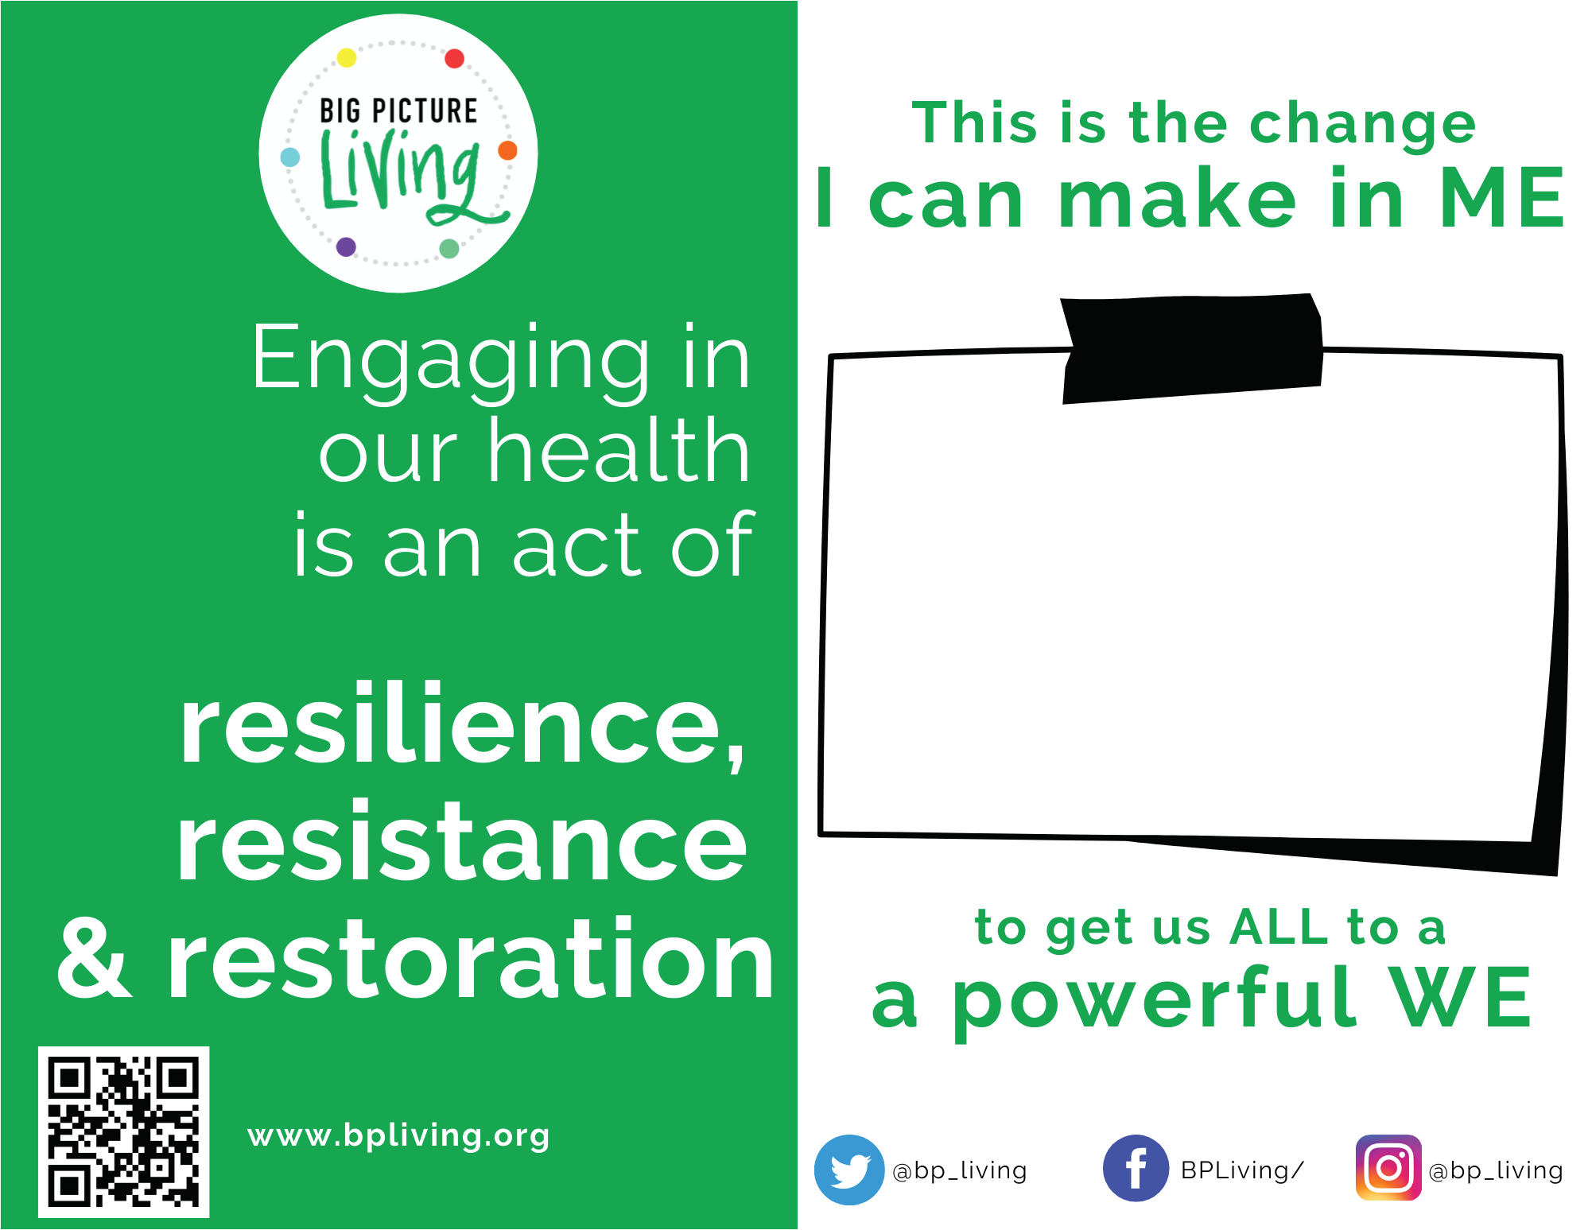
Small Changes for Big Impact
Download the Call to Action from the Website.
Fill it out snap a photo and share on social
#BigPictureLivingChallenge
Follow Big Picture Living on Social Media Instagram: @bp_living
Facebook: @BPLiving
Twitter: @bp_living
YouTube: Big Picture Learning
TikTok: @bp_living
Linkedin: Big Picture Living

Slide 10
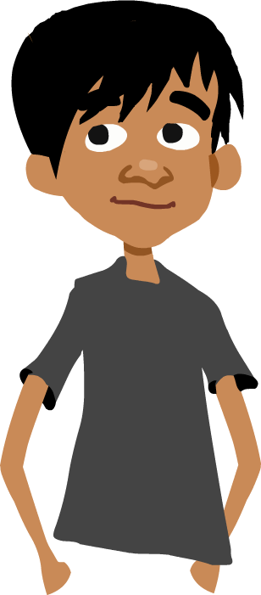
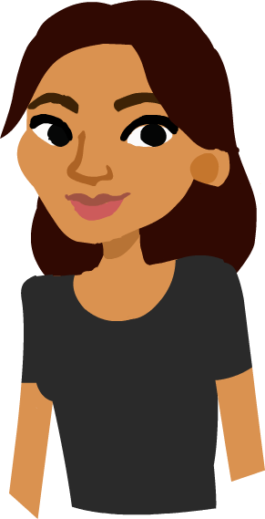
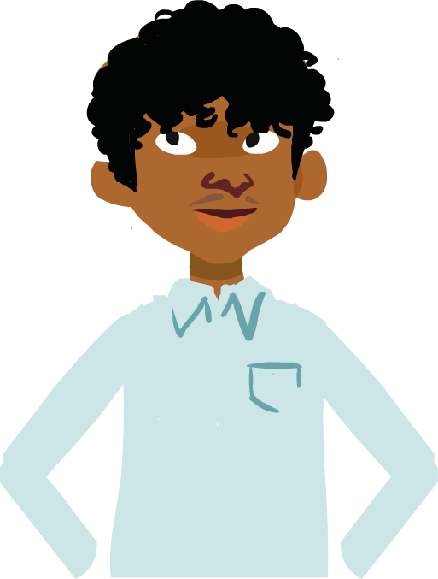
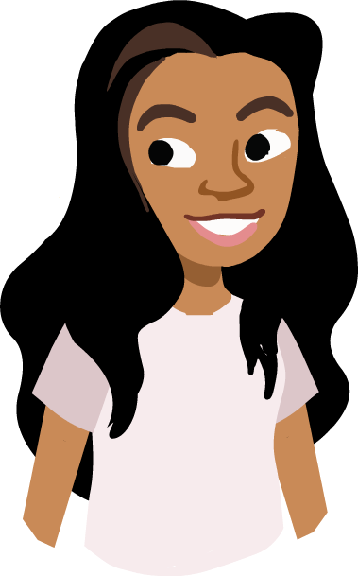
About the 6 Measures

Slide 12
Food is Medicine.
Choose predominantly whole, plant-based foods that are rich in fiber and nutrient dense. Vegetables, fruit, beans, lentils, whole grains, nuts and seeds

Slide 13
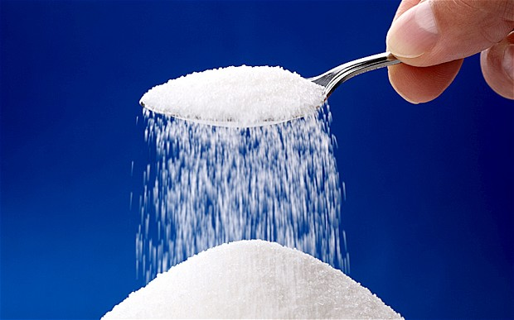
DAY TWO - SUGAR IS BAD
SOME SWEET MATH (SUGAR CALCULATOR)
SCIENCE LAB
NATURAL v UNNATURAL SUGAR
SUGAR SUBSTITUTES

Slide 14
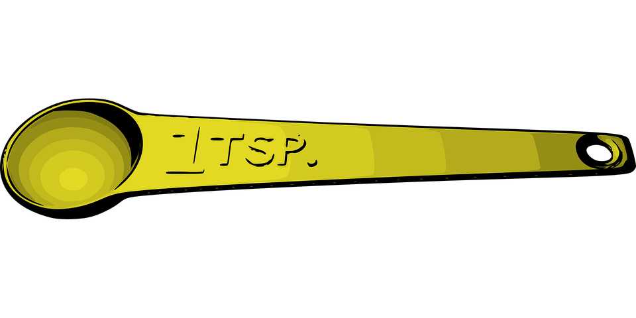
DAY TWO - SUGAR IS BAD
SOME SWEET MATH (SUGAR CALCULATOR)
Grams = Weight
Milliliters = Volume
Teaspoon = Volume
4 grams = 1 teaspoon
Women - 6 teaspoons
Men - 9 teaspoons
There's no nutritional need or benefit that comes from eating added sugar.
Notes:
The AHA suggests an added-sugar limit of no more than 100 calories per day (about 6 teaspoons or 24 grams of sugar) for most women and no more than 150 calories per day (about 9 teaspoons or 36 grams of sugar) for most men.

Slide 15
DAY TWO - SUGAR IS BAD
Science Lab
Analyze What You Drink

Slide 16
DAY TWO - SUGAR IS BAD
NATURAL v UNNATURAL SUGAR
https://www.youtube.com/watch?v=kWWTpe86ja4&ab_channel=TheDoctors
WHAT HAPPENS WHEN YOU EAT TOO MUCH SUGAR
https://www.youtube.com/watch?v=0iMGVbzsD5c&ab_channel=TechInsider

Slide 17
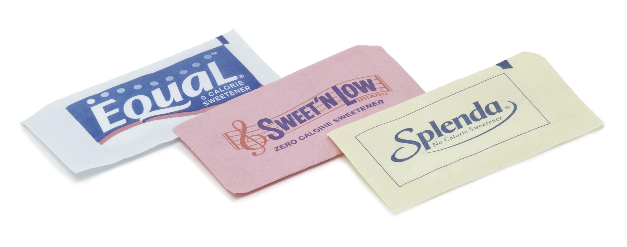
DAY TWO - SUGAR IS BAD
SUGAR SUBSTITUTES
https://www.youtube.com/watch?v=F7x_2f7uQyc&t=315s&ab_channel=MarkHyman%2CMD

Slide 18
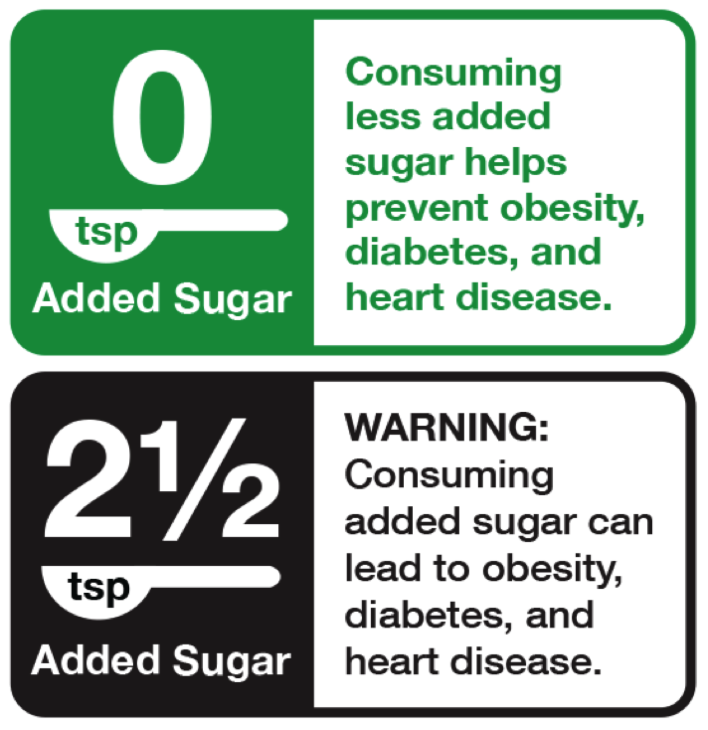
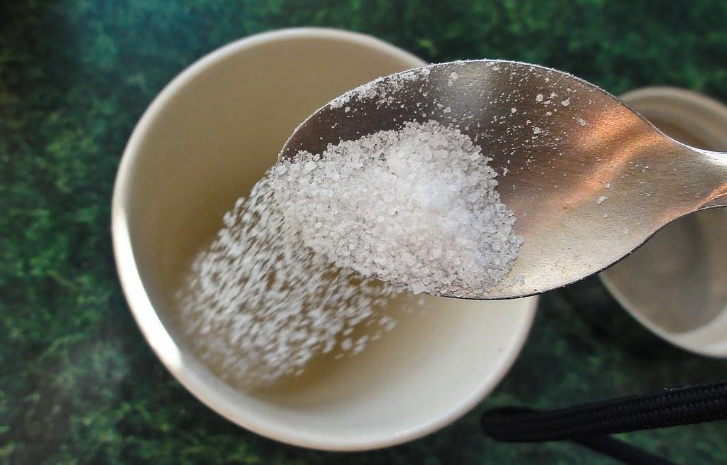
DAY TWO - SUGAR IS BAD
QUITTING ADDED SUGAR
https://www.youtube.com/watch?v=0fbxmdPX-lA&ab_channel=TechInsider

Slide 19
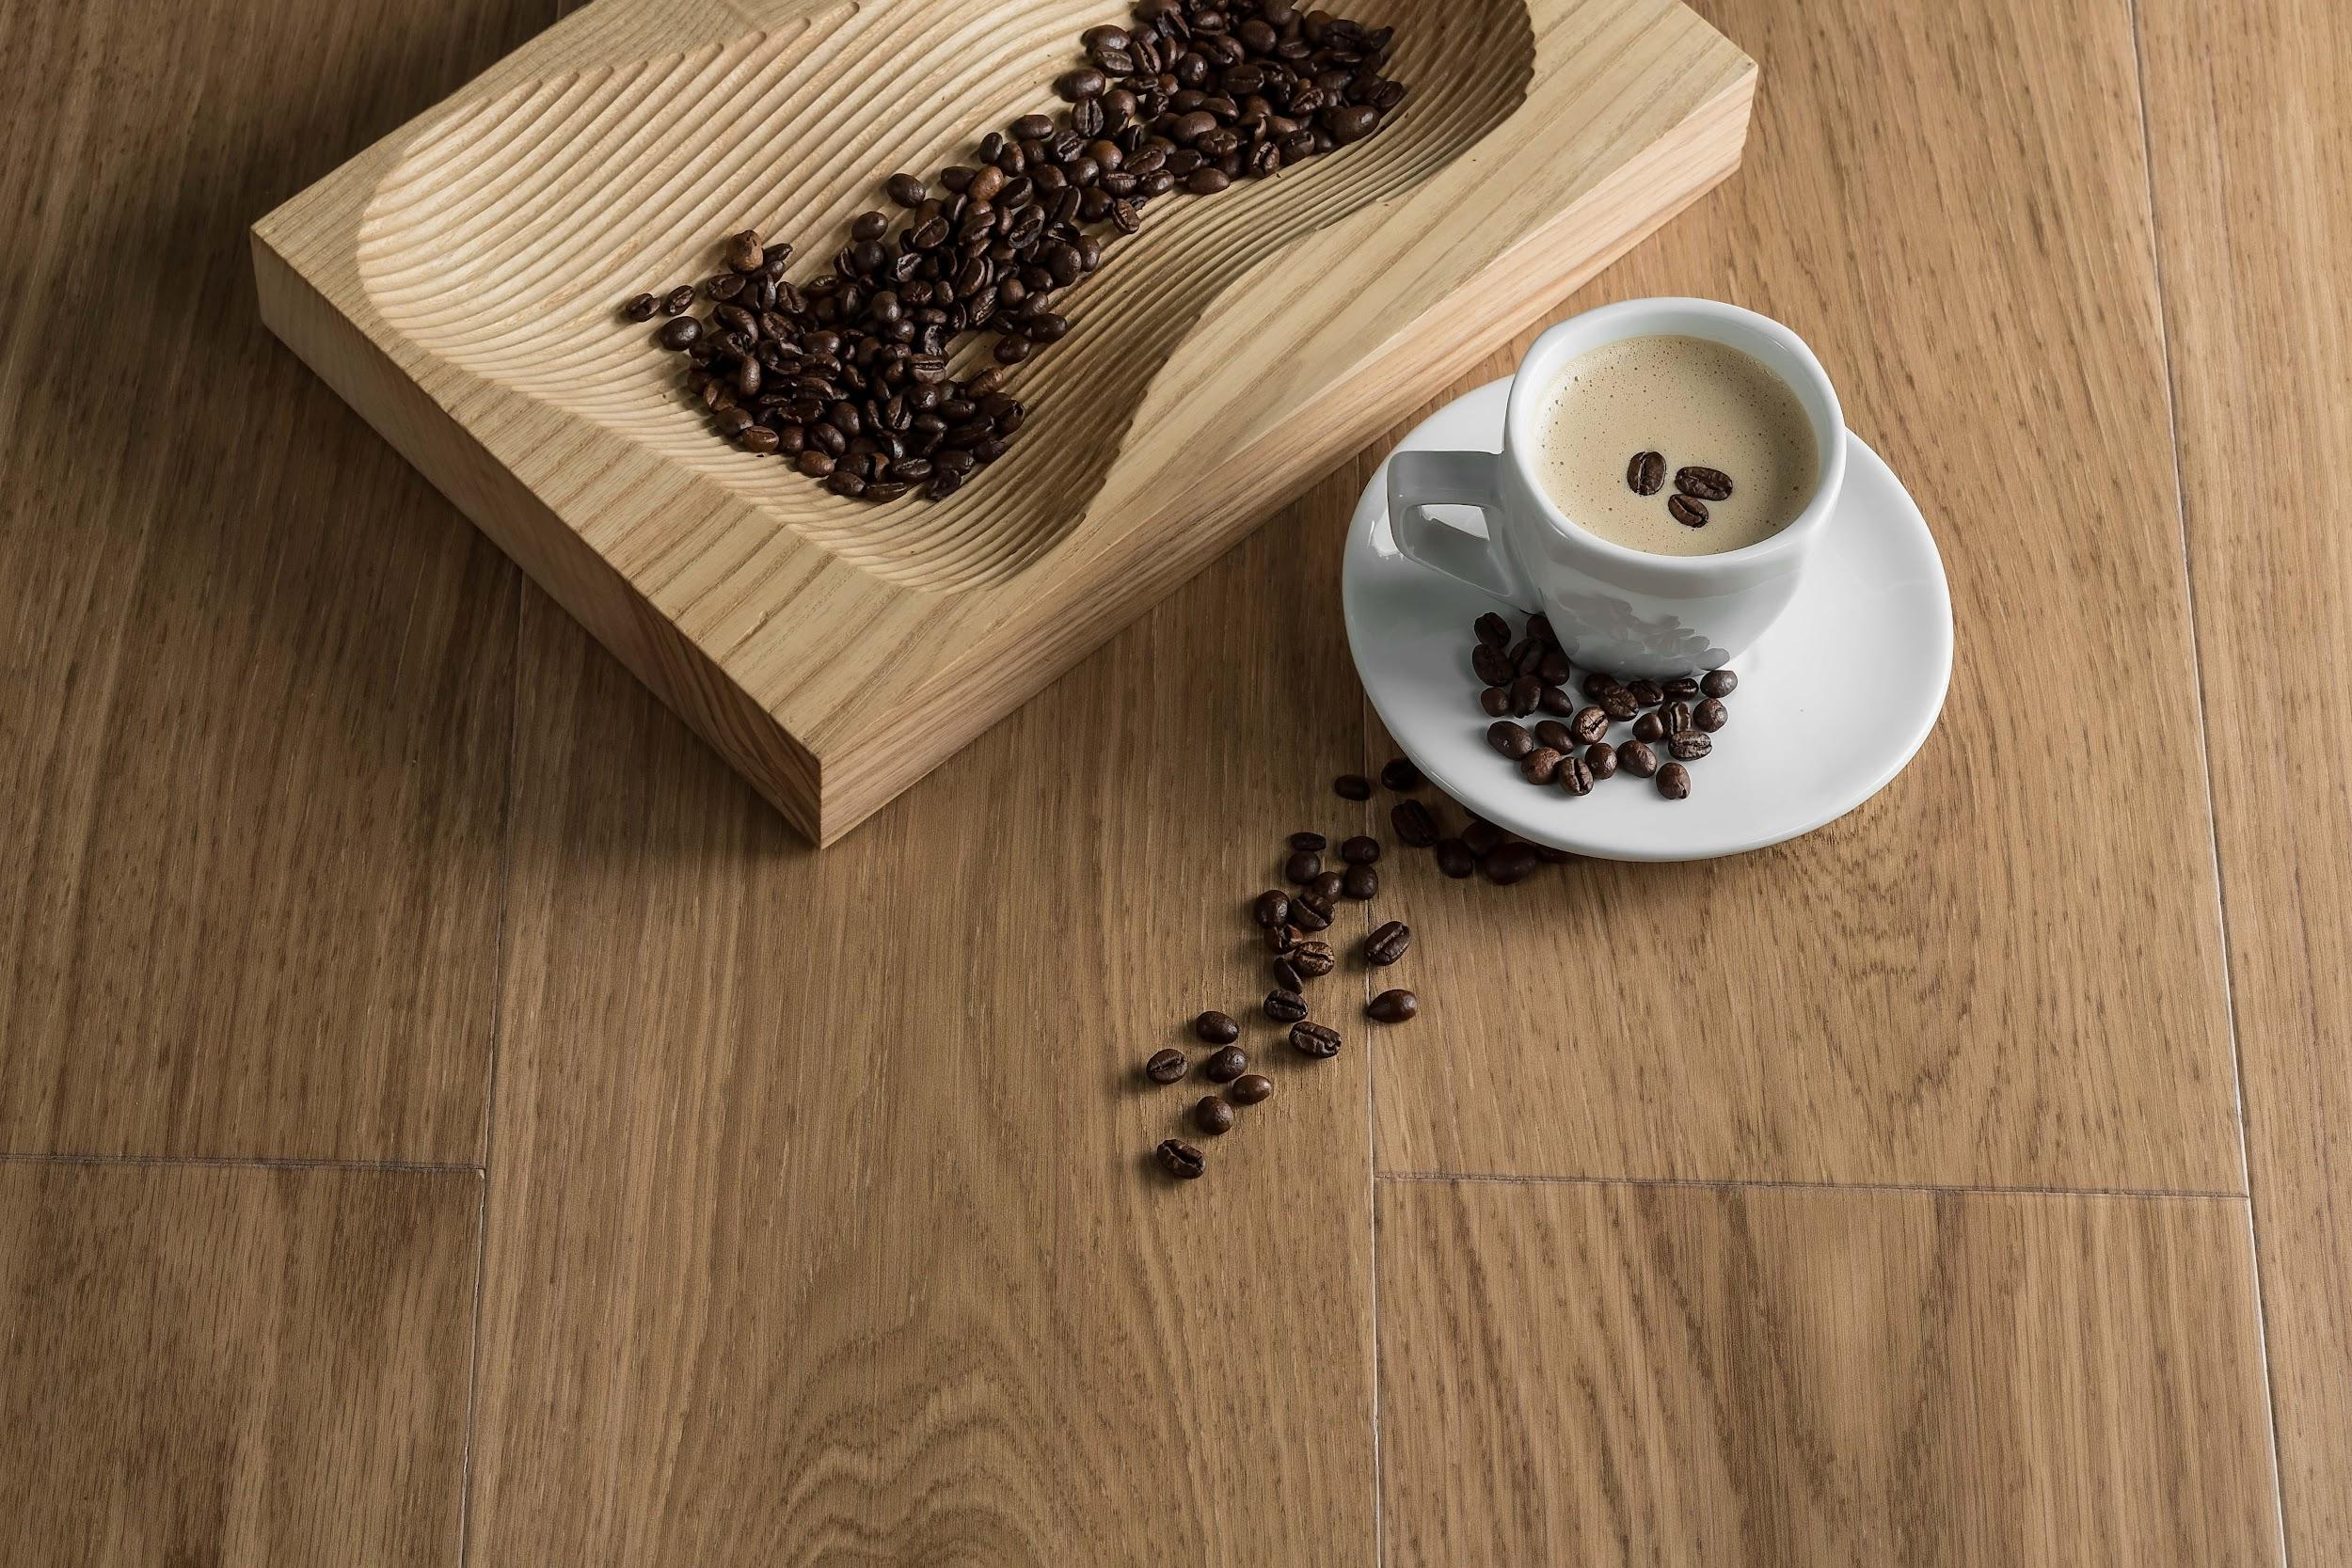
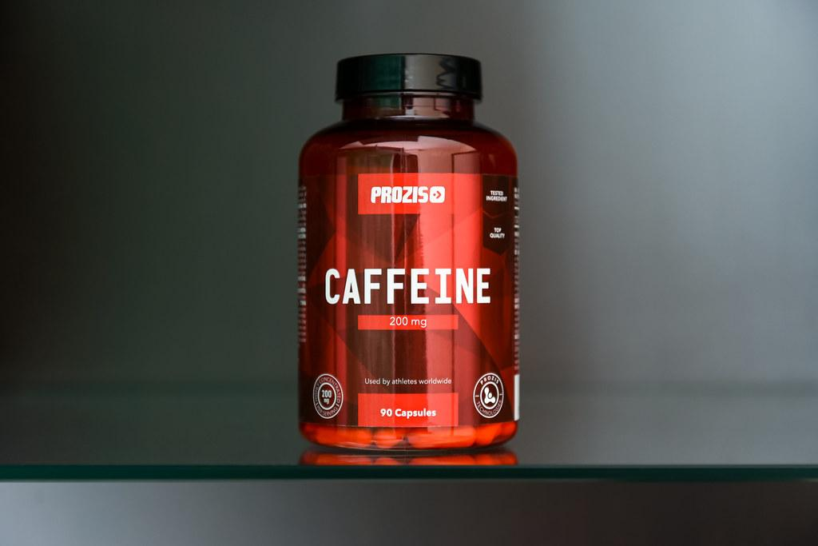
DAY THREE - CAFFEINE DANGERS

Slide 20
DAY THREE- CAFFEINE DANGERS
CAFFEINE INFO
How Caffeine Keeps us Awake
https://www.youtube.com/watch?v=foLf5Bi9qXs&ab_channel=TED-Ed
What Caffeine Does to Us
https://www.youtube.com/watch?v=QBK4SNSjnmY&ab_channel=TechInsider

Slide 21
DAY THREE- CAFFEINE DANGERS
CAFFEINE MATH
Use this equation to figure out how much caffeine you should limit yourself to each day:
(your weight in pounds) x 1.1 =

Slide 22
DAY FOUR - HAVE A PLAN
PROJECT PROPOSAL
Five Days Normal - record your intake
Record the amount of added sugar you eat
Five Days “health conscious” -- record your intake
drink only water or regular milk, nothing else at all.
Try not to eat things with added sugar, record the amount of added sugar you eat.
EXTRA CREDIT -- MONITOR YOUR FAT INTAKE TOO

