Slide 1
Self Care
Why it's important
Created by Samara Watts

Slide 2
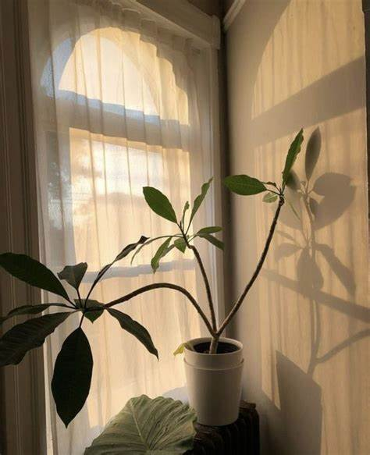
What is self care?
self-care
/ˌselfˈker/
noun
the practice of taking action to preserve or improve one's own health. "autonomy in self-care and insulin administration"

Slide 3
How can Safe Care
Improve your health?
Self Care can help improve you sleeping habits
Self Care improves focus
Self Care strengthens your relationships with others
Self Care Increases Feelings of Worthiness.
Self Care Improves Feelings of Well Being
Self Care Increases Self Confidence
Self Care Reduces Stress and Anxiety

Slide 4
01
4 Different Types of Self Care

Slide 5
Emotional
Self-care
“Today was bad, but tomorrow will be better.”
(Heart)
This type of Self-Care might include making sure to set boundaries on things like time and energy.
Always try to surround yourself with positive people and affirming messages.
Treat people how they want to be treated. .

Slide 6
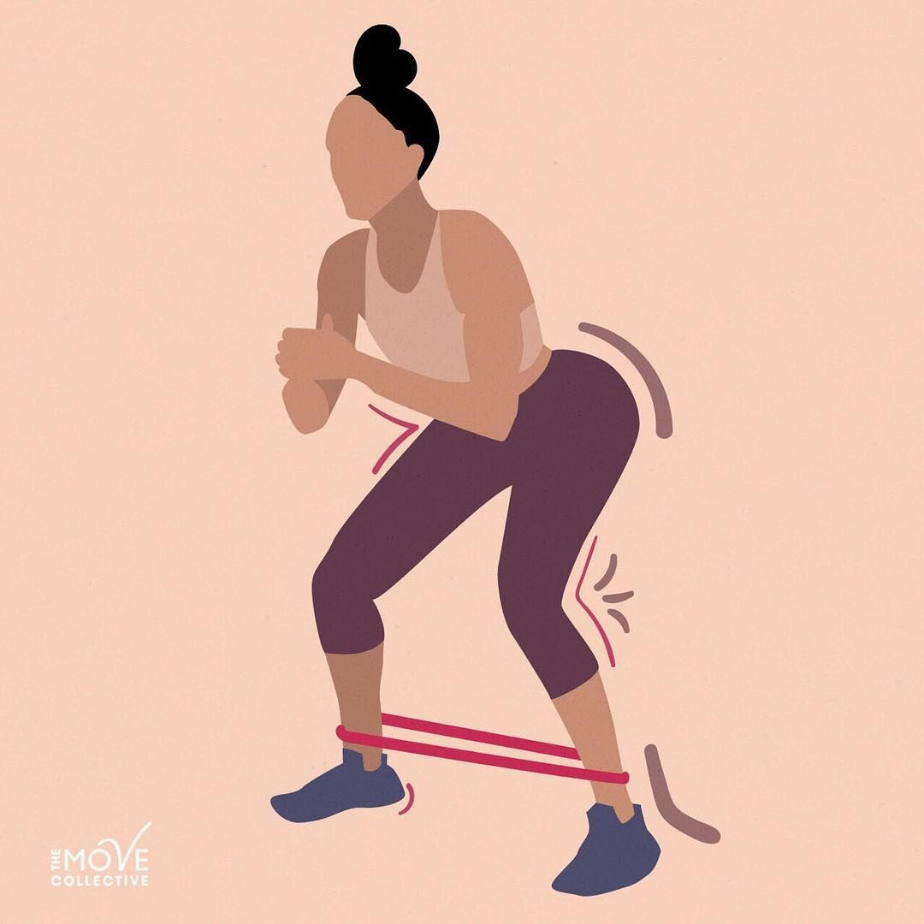
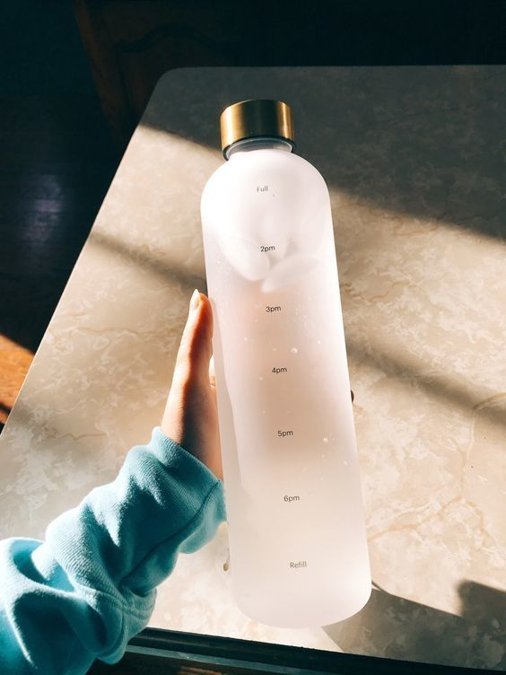
Physical Self-Care
The Body
This type of Self-Care involves maintaining a healthy overall lifestyle. (Drinking lots of water, and making sure that you get plenty of exercise)
This also can included rearranging and decluttering your home,room, office, so that you have a feeling of manageability.

Slide 7
Psychological Self care
The mind.
Activities that may be be tied to Psychological Self-care include both personal and professional development (Character Development lol)
Try to give things in your life that YOU can control the most attention. Like inner thoughts, inner feelings
Make yourself aware of how you feel through journaling, talking with others, meditating, and if you feel comfortable, getting a counselor.
Try to reflect on yourself!!

Slide 8
Spiritual Self Care
The Spirit.
This might include some prayer and meditation.
Try to practice gratitude, spend more time in nature, and be aware of non-material things (MATERIAL GWORL lol)
Practicing mindfulness also helps.

Slide 9
How do I practice self-care?

Slide 10
Through Psychological and Physical care.
I have been personally been focusing on the things that make ME happy. I rearrange my room monthly because it refreshes my system and helps me focus a lot more. I have also been drinking a lot more water, and cutting back on the energy drinks that I drink, overall trying hard to maintain a good healthy lifestyle.

Slide 11
What is Toxic Self-care?

Slide 12
Don’t believe all those “Self-care“ tips on social media.
Putting things off and canceling plans are not self-care.
Self Care tips do not replace mental health services.
Chasing perfection will only damage your mental health.
Dont take social media “tips” to heart. Everyone is different.

Slide 13
Warnings that show whether you are practicing toxic self care or not.
Spending money to make you feel better
Focusing on looks
bailing on plans due to self care
Cutting people off quickly
Indulging in unhealthy food

Slide 14
Summary
Self Care comes in many different forms, but everyone is different. So self care will not look the same for everyone because everyone's mental health in in different places. Self-Care takes care of YOURSELF, not others. It’s literally in the name. Self.

Slide 15
Thank you!!

